Slide 1
High Level Synthesis (HLS) and RTL Implementation in Pair-HMM Algorithm for Sequencing Data Analysis
MSoC Final Presentation 20210122
Group 12
https://github.com/sandy30538/MSOC_Final_Pairhmm
Notes:
希望報告的內容:
1. 解釋原開源碼中的針對HLS 特性的Coding Style，所使用的 HLS Pragma, 解釋為什麼？
2. 分析其電路的 時序，performance, 所使用的Resource
3. 發現原代碼中可能的問題 ，或可以改進的地方
4. 修改原代碼以改進其Throughput， resource。或針對你所需要的design-spec, 做的修改，解釋你做的Trade-off。
classifiers are pipelined
classifiers in the first 3 stages are in parallel and the ones in the other 22 stages are in pipeline

Slide 2
Outline
Introduction
NGS Application
NGS Workflow
NGS Data Analysis Workflow
Pair-HMM Algorithm
HLS Analysis and Implementation
HLS Optimization
Comparison w/ RTL code
Conclusion
References
Notes:
Circular RNA has been linked to some diseases such as cancer.
Recent discoveries have shown that circular RNAs involved in central nervous system
diseases, such as Alzheimers disease and Epithelial to Mesenchymal
Transition (EMT, 上皮細胞間質轉化，癌症轉移的關鍵機制) thus in Carcinogenesis of various forms of malignancies
[6, 7], are suitable candidates to become genetic biomarkers
sponges for microRNA (miRNA), influence the fine-tuning gene expression

Slide 3
Outline
Introduction
NGS Application
NGS Workflow
NGS Data Analysis Workflow
Pair-HMM Algorithm
HLS Analysis and Implementation
HLS Optimization
Comparison w/ RTL code
Conclusion
References
Notes:
Circular RNA has been linked to some diseases such as cancer.
Recent discoveries have shown that circular RNAs involved in central nervous system
diseases, such as Alzheimers disease and Epithelial to Mesenchymal
Transition (EMT, 上皮細胞間質轉化，癌症轉移的關鍵機制) thus in Carcinogenesis of various forms of malignancies
[6, 7], are suitable candidates to become genetic biomarkers
sponges for microRNA (miRNA), influence the fine-tuning gene expression

Slide 4
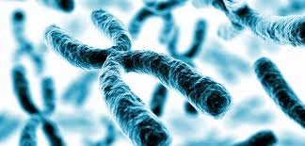
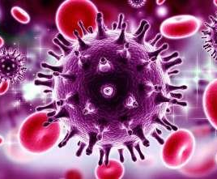
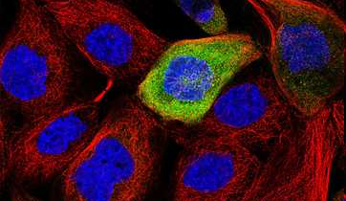

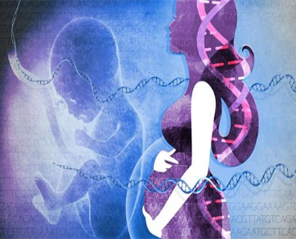
Introduction: NGS Application
The power of high-throughput sequencing is harnessed by many researchers to address diverse biological problem
Virus Quick
Testing
Molecular
Biology
Precision
Medicine
Non-invasive
Prenatal Testing
[1]
[1] L. Barzon, et al., Int J Mol Sci, 2011.

Slide 5
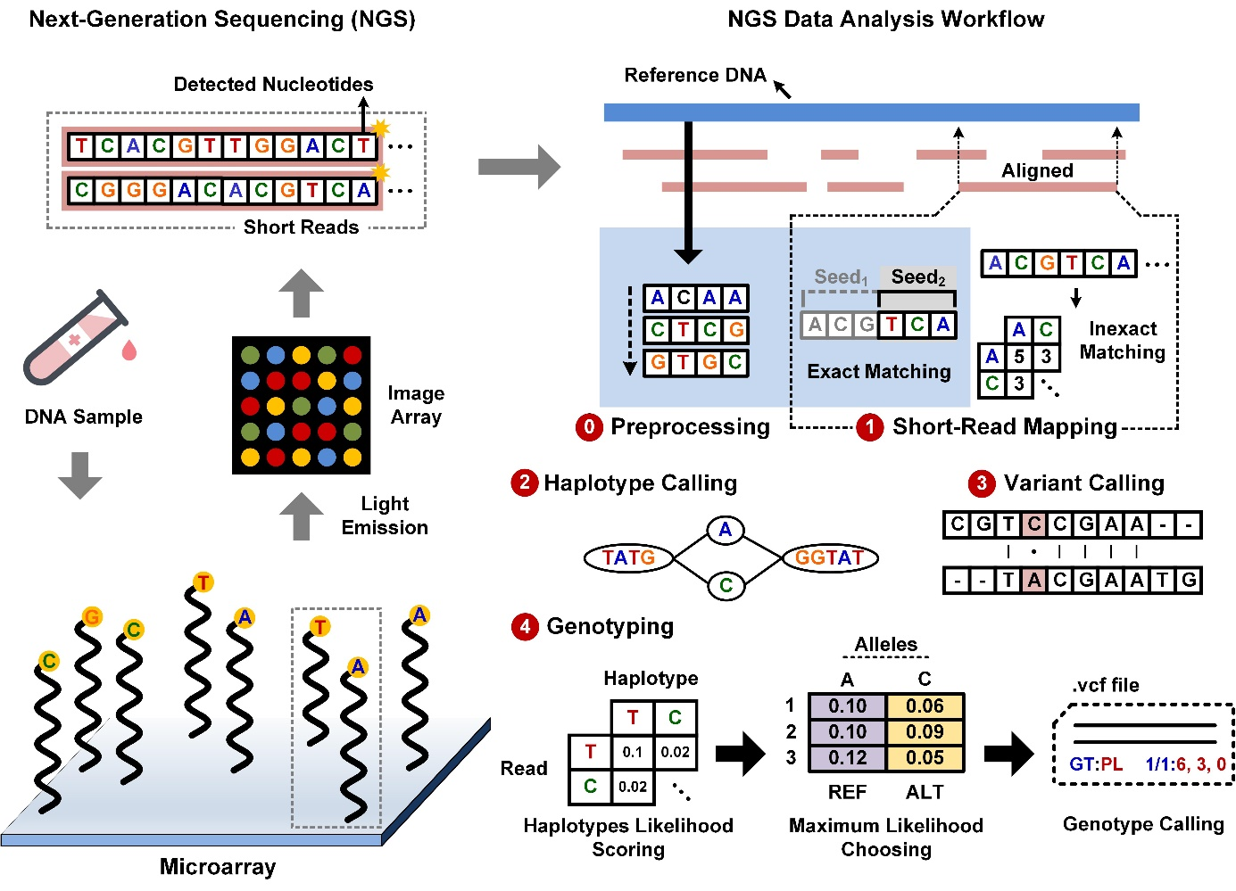

Introduction: NGS Workflow
Hundreds of millions of DNA segments were anchored and amplified on a microarray, and then short-read raw data is output by sequencing by synthesis
Next-Generation Sequencing (NGS) Workflow [2]
Image Array
Short-read Data
Light Emission
Library Preparation
Cluster Amplification
[2] Y.-C. Wu, et al., ISSCC, Feb. 2020.

Slide 6


Introduction: NGS Data Analysis Workflow
3×10⁹ bp
The short-read raw data from NGS should be analyzed to find the variants of the sample
Analysis workflow consists of Preprocessing, Short-read Mapping, Haplotype Calling, Variant Calling and Genotyping
Final result will be variant call format (.vcf) storing gene sequence variations
Preprocessing
Short-read Raw Data
100-200 bp
Reference Genome
TACC…GTA
Short-read Mapping
TGCA…ATC
Aligner
….
Haplotype Calling
Variant Calling
Genotyping
GATK
Haplotype Caller

Slide 7
Introduction: Why We Should Accelerate NGS Analysis w/ Hardware?
There are several reasons that why we want to accelerate GATK HaplotypeCaller in NGS data analysis with hardware
The total length of human genome is about 3 × 10⁹ bp
According to recent C++ solution [3], it took about 48 hours for whole genome data
The step for short-read mapping had already been implemented
Percentage of Processing Time for Each Step [4]
Haplotype Calling
+ Variant Calling
12.19%
59.35%
28.45%
Genotyping
(Pair-HMM algorithm)
Short-read Mapping
[3] H.-W. Kang and J.-H. Hung, National Chiao Tung University, Nov. 2019.
[4] https://www.intel.com/content/www/us/en/healthcare-it/solutions/documents/deploying-gatk-best-practices-paper.html

Slide 8
Outline
Introduction
NGS Application
NGS Workflow
NGS Data Analysis Workflow
Pair-HMM Algorithm
HLS Analysis and Implementation
HLS Optimization
Comparison w/ RTL code
Conclusion
References
Notes:
Circular RNA has been linked to some diseases such as cancer.
Recent discoveries have shown that circular RNAs involved in central nervous system
diseases, such as Alzheimers disease and Epithelial to Mesenchymal
Transition (EMT, 上皮細胞間質轉化，癌症轉移的關鍵機制) thus in Carcinogenesis of various forms of malignancies
[6, 7], are suitable candidates to become genetic biomarkers
sponges for microRNA (miRNA), influence the fine-tuning gene expression

Slide 9



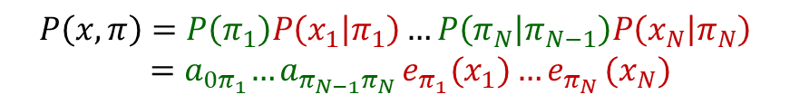











Pair-HMM Algorithm (1/2)
GATK’s HaplotypeCaller [5] assumes that haplotype and short-read follow a Pair Hidden Markov Model to give probabilities over sequences
Given a sequence x = x₁ x₂ … x_{N}
PairHMM Model
Transition Probabilities
and state sequence $π$ =$π$₁$π$₂ …$π$_{N}
x₁
x₂
…
x_{N}
1-2$δ$
Emission Probabilities
Match/Mismatch
M
$π$₁
$π$₂
…
$π$_{N}
Match/Mismatch:
$P$($x_{i},y_{j}$)
$$δ$$
$$δ$$
Insertion:
$Q(x_{i}$)
I
1-$ε$
1-$ε$
D
Deletion:
$Q(y_{j}$)
The probability of this scenario is
$$ε$$
$$ε$$
$$P\left(x,π\right)=P\left(π_{1}\right)P\left(x_{1} | π_{1}\right)…P\left(π_{N} | π_{N−1}\right)P\left(x_{N} | π_{N}\right)$$
$${ =a}_{0π_{1}}{…a}_{π_{N−1}π_{N}}e_{π_{1}}(x_{1}){…e}_{π_{N}}(x_{N})$$
Insertion
Deletion
Transition Probabilities
Emission Probabilities
[5] Genome Analysis Toolkit, Broad Institute.

Slide 10
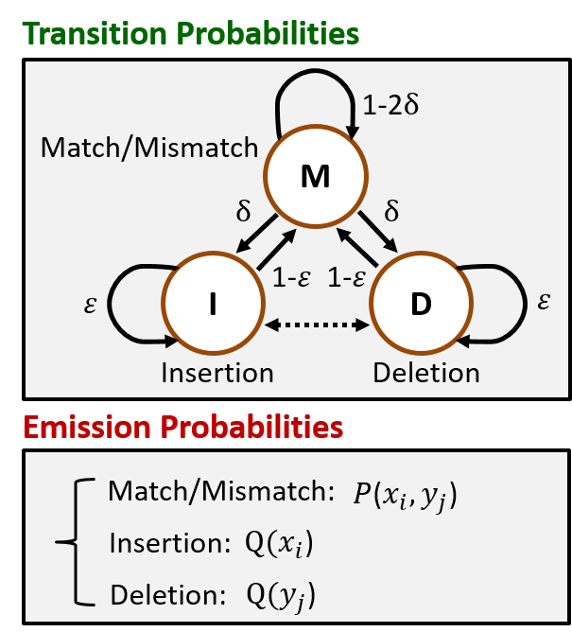

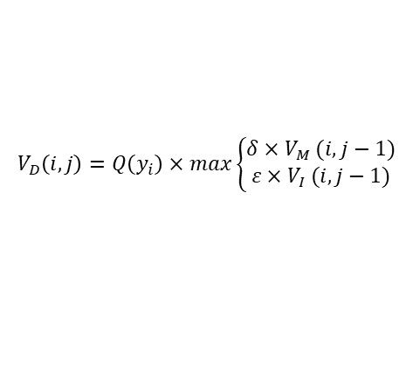
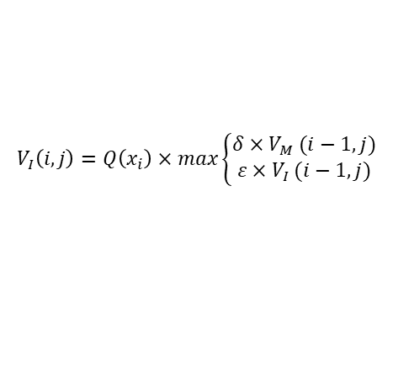
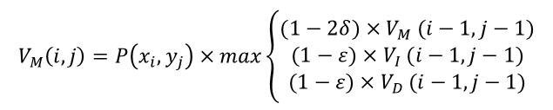
Pair-HMM Algorithm (2/2)
After short-reads and haplotypes being ready and the PairHMM being defined, the path that gives the maximum likelihood of observing read given haplotype is calculated
$$V_{M}\left(i,j\right)=P\left(x_{i},y_{j}\right)×max\left\{\begin{aligned}(1−2δ){×V}_{M}(i−1, j−1) \\ (1−ε){×V}_{I}(i−1, j−1) \\ (1−ε){×V}_{D}(i−1, j−1)\end{aligned}\right.$$
Mismatch
ACGTAC
ACTTAC
M
M
M
$$V_{I}\left(i,j\right)=Q\left(x_{i}\right)×max\left\{\begin{aligned}δ{×V}_{M}(i−1, j) \\ ε{×V}_{I}(i−1, j)\end{aligned}\right.$$
Insertion
$$V_{D}\left(i,j\right)=Q\left(y_{i}\right)×max\left\{\begin{aligned}δ{×V}_{M}(i, j−1) \\ ε{×V}_{I}(i, j−1)\end{aligned}\right.$$
AC- TAC
ACTTACG
I
I
I
i: position in x sequence, j: position in y sequence
Deletion
D
D
D
Maximum likelihood H(i,j)
$H\left(i,j\right)$= $max\left\{\begin{aligned}V_{M}\left(i,j\right) \\ V_{I}\left(i,j\right) \\ V_{D}\left(i,j\right)\end{aligned}\right.$
ACTGTAC
AC- -TACG
t = 1
t = 2
t = 3

Slide 11
Outline
Introduction
NGS Application
NGS Workflow
NGS Data Analysis Workflow
Pair-HMM Algorithm
HLS Analysis and Implementation
HLS Optimization
Comparison w/ RTL code
Conclusion
References
Notes:
Circular RNA has been linked to some diseases such as cancer.
Recent discoveries have shown that circular RNAs involved in central nervous system
diseases, such as Alzheimers disease and Epithelial to Mesenchymal
Transition (EMT, 上皮細胞間質轉化，癌症轉移的關鍵機制) thus in Carcinogenesis of various forms of malignancies
[6, 7], are suitable candidates to become genetic biomarkers
sponges for microRNA (miRNA), influence the fine-tuning gene expression

Slide 12
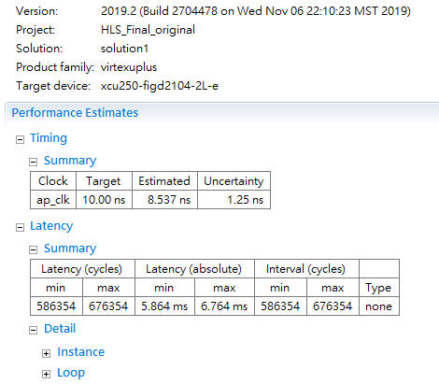
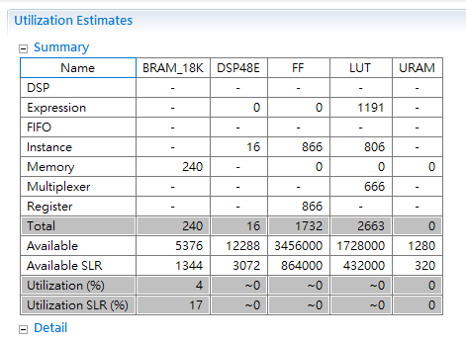
Baseline Pairhmm (without pragma, forward algorithm)

Slide 13
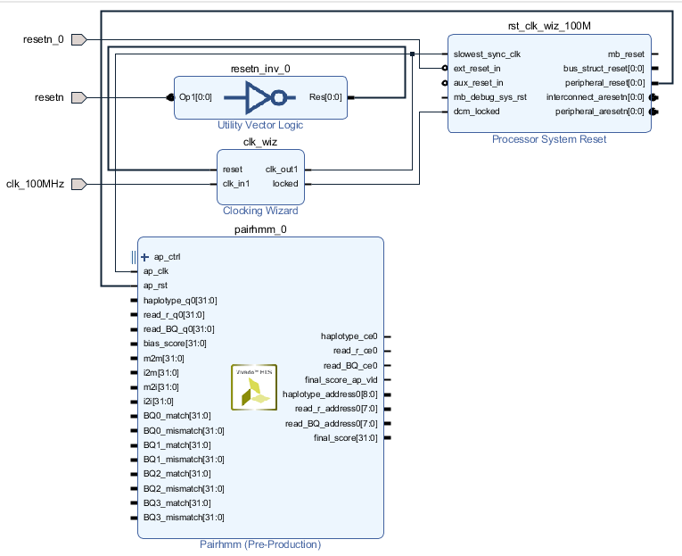
Baseline Pairhmm (without pragma, forward algorithm)

Slide 14
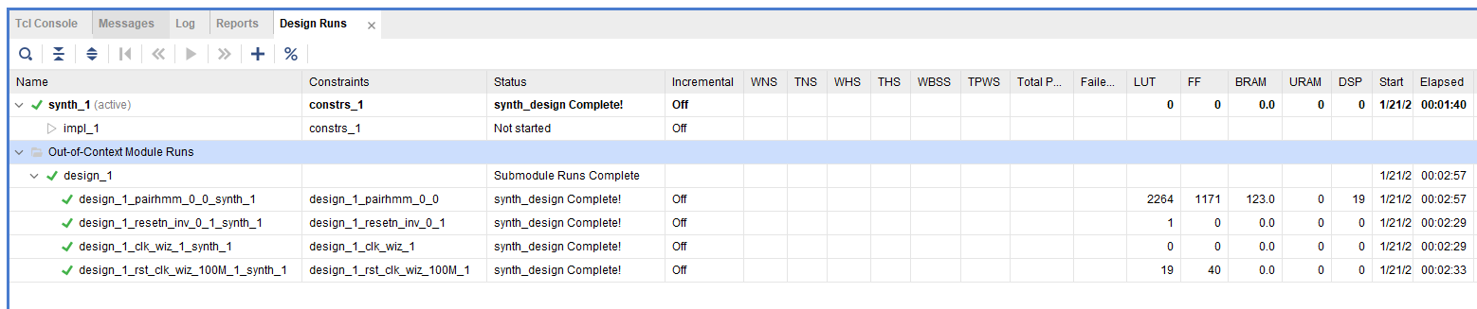
Baseline Pairhmm (without pragma, forward algorithm)

Slide 15
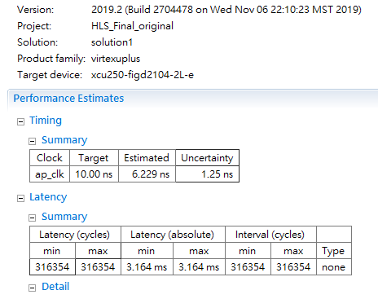
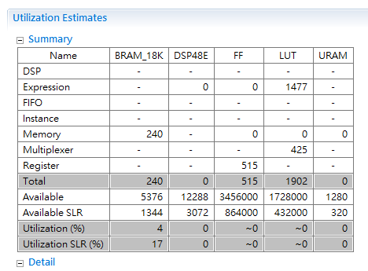
Optimized Pairhmm (without pragma, log domain)

Slide 16
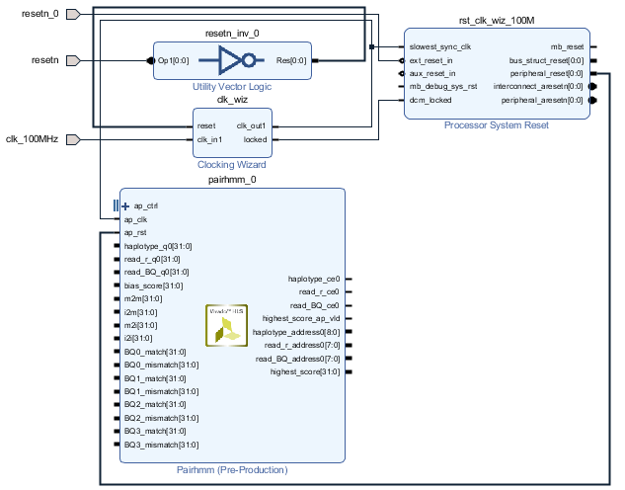
Optimized Pairhmm (without pragma, log domain)

Slide 17
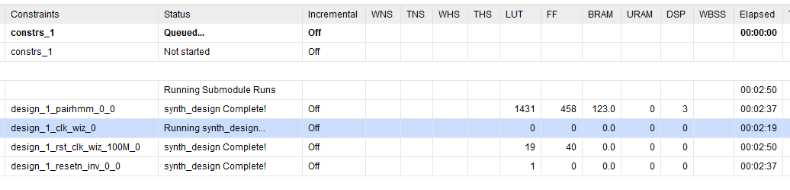
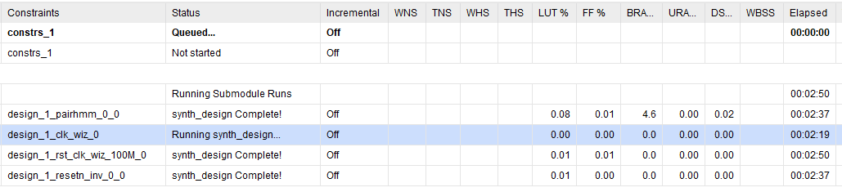
Optimized Pairhmm (without pragma, log domain)

Slide 18
Outline
Introduction
NGS Application
NGS Workflow
NGS Data Analysis Workflow
Pair-HMM Algorithm
HLS Analysis and Implementation
HLS Optimization
Comparison w/ RTL code
Conclusion
References
Notes:
Circular RNA has been linked to some diseases such as cancer.
Recent discoveries have shown that circular RNAs involved in central nervous system
diseases, such as Alzheimers disease and Epithelial to Mesenchymal
Transition (EMT, 上皮細胞間質轉化，癌症轉移的關鍵機制) thus in Carcinogenesis of various forms of malignancies
[6, 7], are suitable candidates to become genetic biomarkers
sponges for microRNA (miRNA), influence the fine-tuning gene expression

Slide 19
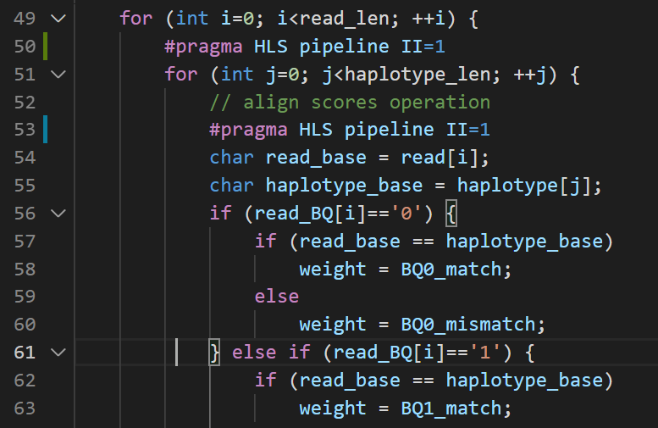

HLS Analysis: Baseline
The II Violation in module 'pairhmm' (Loop: Loop 6): Unable to enforce a carried dependence constraint (II = 1, distance = 1, offset = 1)

Slide 20
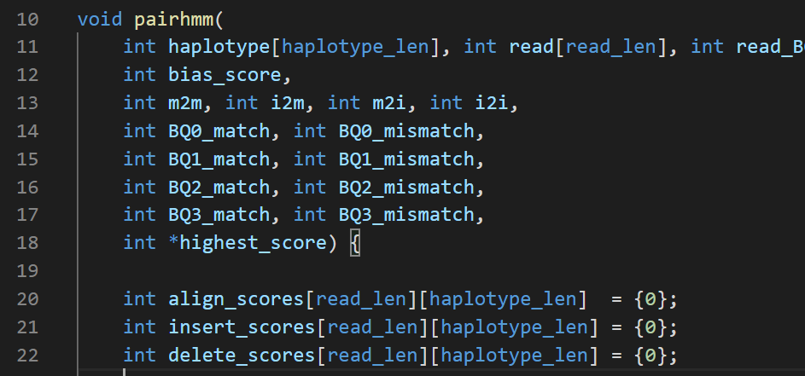
HLS Optimization: w/ Array Partition (1/2)

Slide 21
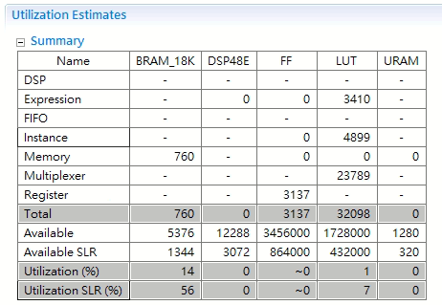
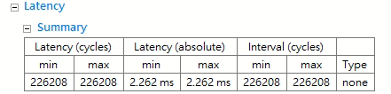
HLS Optimization: w/ Array Partition (2/2)
W/ array partition

Slide 22
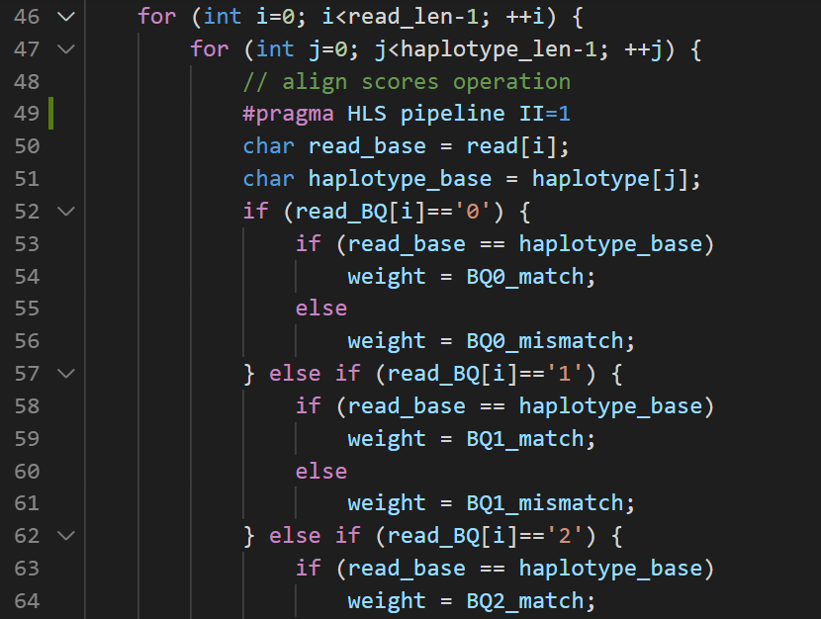
HLS Optimization: w/ Array Partition and Pipeline (1/2)

Slide 23
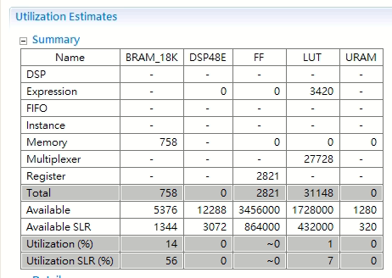
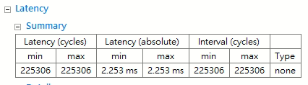
HLS Optimization: w/ Array Partition and Pipeline (2/2)
W/ array partition
W/ array partition + pipeline
11

Slide 24
Outline
Introduction
NGS Application
NGS Workflow
NGS Data Analysis Workflow
Pair-HMM Algorithm
HLS Analysis and Implementation
HLS Optimization
Comparison w/ RTL code
Conclusion
References
Notes:
Circular RNA has been linked to some diseases such as cancer.
Recent discoveries have shown that circular RNAs involved in central nervous system
diseases, such as Alzheimers disease and Epithelial to Mesenchymal
Transition (EMT, 上皮細胞間質轉化，癌症轉移的關鍵機制) thus in Carcinogenesis of various forms of malignancies
[6, 7], are suitable candidates to become genetic biomarkers
sponges for microRNA (miRNA), influence the fine-tuning gene expression

Slide 25
Performances Comparison with Customized RTL
 | HLS Baseline | HLS Algorithm Optimized | HLS Pragma Optimized | HLS Systolic Array | RTL Customized
Feature | None | Float → Fixed | Float → Fixed Pipelined Array Partition | Float → Fixed Pipelined Array Partition No Dependency | Float → Fixed Pipelined Array Partition No Dependency
CLB LUT | 2,663 | 1,902 | 31,148 | 35,374 | 29,250
CLB reg | 866 | 515 | 2,821 | 19,360 | 17,250
DSP | 16 | 0 | 0 | 0 | 0
BRAM | 240 | 240 | 758 | 0 | 0
Clock Freq. | 117 MHz | 160 MHz | 149 MHz | 149MHz | 200 MHz
Latency | 586,354 | 316,354 | 226,208 | 900 | 450
Design Time (hours) | 1 | 1.3 | 1.5 | 2.2 | 45
Notes:
baseline: float, forward
Int, log, 變成加
對2加array partition和pipeline.
Systolic Array
RTL

Slide 26
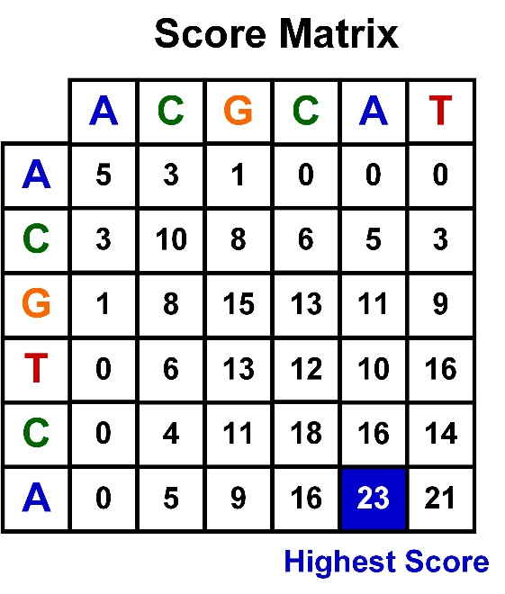
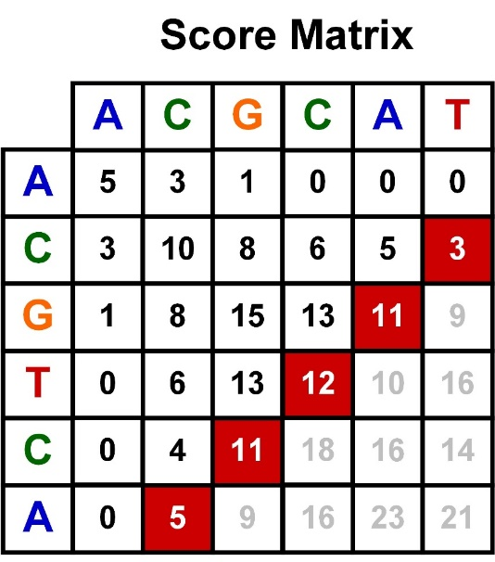
Data Dependency / Hardware Thinking
Conventional Software Approach
Anti-Diagonal Approach

Slide 27
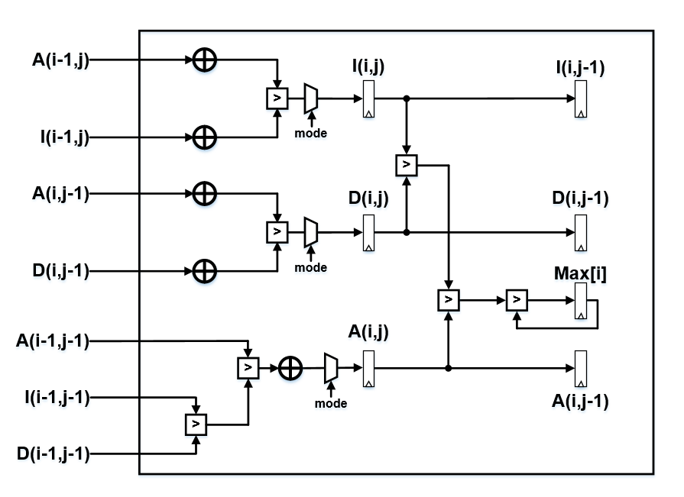
Comparison with Customized RTL
Pros
Accurate register pipelining
Elegant compact architecture
Precise word-length
Customized dataflow
Cons
Long design time
Long turnaround time
Hard for debugging and verification

Slide 28
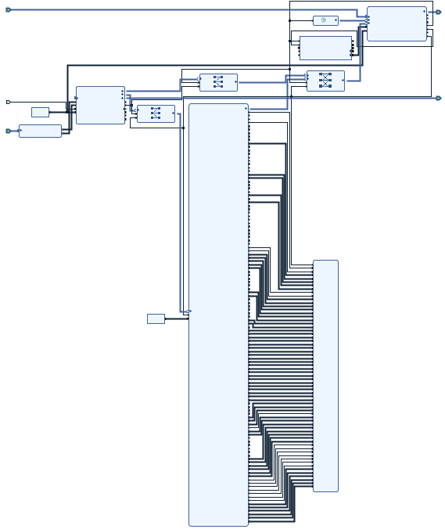
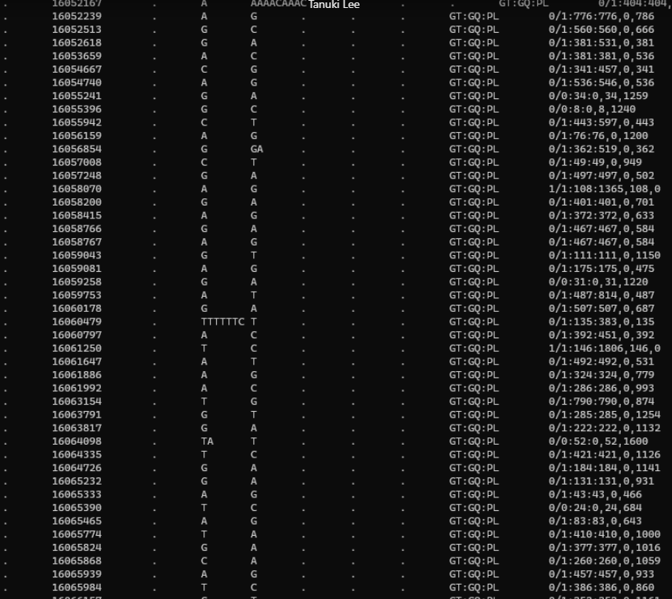
Overall System Architecture
pair-hmm circuit integrated in complete system
GT:GQ:PL 0/1: 776: 776, 0, 786
Integrated Block
Output Results Verified
Sensitivity: 99.77%
Precision: 99.79%

Slide 29
Outline
Introduction
NGS Application
NGS Workflow
NGS Data Analysis Workflow
Pair-HMM Algorithm
HLS Analysis and Implementation
HLS Optimization
Comparison w/ RTL code
Conclusion
References
Notes:
Circular RNA has been linked to some diseases such as cancer.
Recent discoveries have shown that circular RNAs involved in central nervous system
diseases, such as Alzheimers disease and Epithelial to Mesenchymal
Transition (EMT, 上皮細胞間質轉化，癌症轉移的關鍵機制) thus in Carcinogenesis of various forms of malignancies
[6, 7], are suitable candidates to become genetic biomarkers
sponges for microRNA (miRNA), influence the fine-tuning gene expression

Slide 30
Conclusion
High-level synthesis (HLS) enables ultra-fast FPGA prototyping, reducing overall development time by more than 20x.
HLS brings it a promising solution for software developers to design hardware applications with FPGA.
Performances depend on proposed architecture significantly. (hardware-thinking algorithms)
Customized RTL design benefits from precise word-length control and cycle-accurate architecture, slightly improving overall resources usage and latency.
Who would be mostly benefit from HLS: software engineers with hardware architecture concept and experience.

Slide 31
References
[1] Lusia Barzon, Enrico Lavezzo, Valentina Militello, Stefano Toppo, Giorgio Palu, “Applications of Next-Generation Sequencing Technologies to Diagnostic Virology,” International Journal of Molecular Sciences, November. 2011.
[2] Y.-C. Wu et al., “A Fully Integrated Genetic Variant Discovery SoC for Next-Generation Sequencing,” Int. Solid-State Circuits Conference (ISSCC), 2020.
[3] H.-W. Kang and J.-H. Hung, “Optimization of the Variant Calling Workflow for Whole Genome Sequencing,” National Chiao Tung University in Partial Fulfillment of the Requirements for the Degree of Master in Computer Science, Nov. 2019.
[4] https://www.intel.com/content/www/us/en/healthcareit/solutions/documents/deploying-gatk-best-practices-paper.html
[5] Genome Analysis Toolkit, Broad Institute. “HaplotypeCaller in a nutshell,” https://gatk.broadinstitute.org/hc/en-us/articles/360035531412.

Slide 32
Q & A

